Slide 1

Decoding Arrest Decisions in Terry Traffic Stops
Terry v. Ohio
Data scientist:
Eric rono
Date: 01/09/2024

Slide 2
BUSINESS UNDERSTANDING
Terry Stops, rooted in the principle of “reasonable suspicion,” allow police officers to temporarily detain individuals for investigation. However, the decision to escalate a stop to an arrest can be influenced by a variety of factors, some of which may not be immediately clear or consistent. This project seeks to address the complexities involved in these critical decisions through a multifaceted approach:

Slide 3
Cont…
Identifying Key Factors: The project aims to determine the primary factors that influence whether an arrest is made following a Terry Stop. These factors could range from situational elements, such as time and location, to individual characteristics, including behavior and demeanor during the stop. Understanding these variables is crucial for identifying patterns and ensuring that decisions are made based on objective criteria.
Predictive Modeling: To systematically analyze these factors, the project will develop a binary classification model capable of predicting the likelihood of an arrest. By leveraging historical data, this model will provide a data-driven approach to anticipate outcomes, allowing law enforcement agencies to understand the potential impact of various factors on arrest decisions.

Slide 4
Cont…
Policy Evaluation: A key focus of the project is to provide insights into the role of demographic factors, such as race and gender, in arrest decisions. By examining these elements, the project will help ensure that arrest decisions are fair and unbiased, fostering greater transparency and addressing ethical concerns in policing practices.
Resource Allocation: Understanding the patterns and factors that lead to arrests can also assist law enforcement agencies in better allocating their resources. By identifying areas where arrests are more likely or understanding the circumstances that typically lead to such outcomes, agencies can deploy their personnel more effectively and make informed decisions about training and policy development.

Slide 5
Research Questions:
Prediction Accuracy: How well can we predict whether a traffic stop will occur using factors like location, time of day, and demographic information?
Key Influences: Which factors are most important in predicting traffic stops? Are there any surprising trends or patterns?
Bias and Fairness: Does the model show any bias in its predictions? For example, does it unfairly target certain groups of drivers more than others?

Slide 6
Data Understanding Overview
Dataset Overview
The Terry Traffic Stops dataset contains a comprehensive record of 61,021 police stops. This data is organized across 23 columns, providing a detailed view of each incident.
Data Structure
The dataset's structure comprises 4 integer columns and 19 object columns. The object columns likely contain strings or mixed data types, allowing for a diverse range of information to be captured.

Slide 7
Cont…
Missing Data
While most columns are complete, there are two notable exceptions. The "Weapon Type" column has the highest number of null values at 32,565, suggesting that weapon information is not always available or applicable. Additionally, the "Officer Squad" column has 561 missing entries.
Key Column Categories
4.1 Subject Information The dataset includes details about the subjects of the stops, such as their age group, ID, perceived race, and perceived gender.

Slide 8
Cont…
4.2 Officer Details Information about the officers conducting the stops is also recorded, including their ID, year of birth (YOB), gender, and race.
4.3 Stop Characteristics Each stop is documented with a unique Terry Stop ID, along with the stop resolution and the reported date and time.
4.4 Location Data The geographic context of each stop is captured through precinct, sector, and beat information.
Numerical Insights
The "Officer YOB" column provides interesting demographic data about the police force. Birth years range from 1900 to 2002, with a mean of 1984. Both the Subject ID and Terry Stop ID columns show a wide range of values, likely serving as unique identifiers for each entry.

Slide 9
Cont…
Categorical Data Highlights
Several columns offer insights into the nature of the stops and the diversity of those involved:
Stop Resolution has 5 unique categories, indicating various outcomes of the stops.
There are 9 distinct precincts represented in the data.
Officer Race is categorized into 9 groups.
Subject Perceived Race has 11 unique categories, suggesting a detailed approach to recording racial data.

Slide 10
Cont…
Flag Columns
The dataset includes two flag columns that provide quick reference points:
Arrest Flag is binary, indicating whether an arrest was made.
Frisk Flag has 3 unique values, potentially indicating different levels or types of frisking procedures.

Slide 11
Data Cleaning
Identify and handle missing values
Scrub the data to remove any inaccuracies or inconsistencies
Transform and organize the data into a standardized format for analysis
Enhance the quality and usability of the data through restructuring and formatting adjustments.
Handle Missing Values: Drop rows with missing critical data and impute others.

Slide 12
Exploratory Data Analysis
Univariate Analysis
Distribution Plots: Visualize the distribution of numerical features and check for outliers in the dataset.
Statistical summary: Generate descriptive statistics of the numerical features in the dataset.
Frequency Counts: Explore the frequency counts of categorical features and detect rare categories in the dataset.

Slide 13
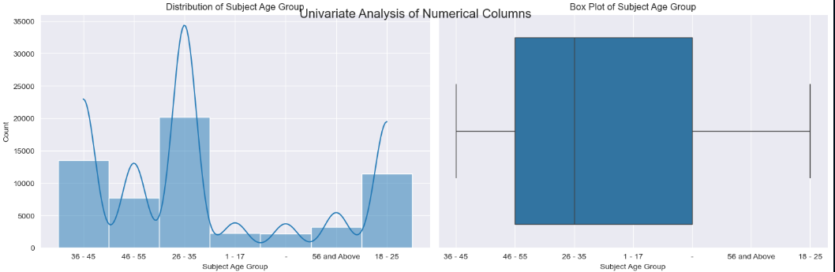
Age groups distribution of, indicating that the 26-35 age group has the highest count, followed by the 18-25 age group. The other age groups (36-45, 46-55, 56 and above, and 1-17) have lower counts. The right side shows a box plot of the age groups, where the 26-35 age group appears to be the most common, with the interquartile range extending from approximately 18-45. There is also a noticeable spread in age distribution, with some outliers or less frequent ages present.

Slide 14
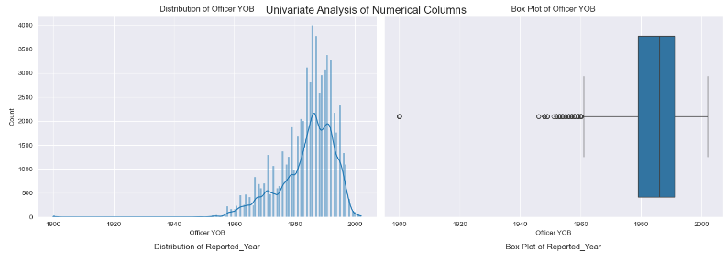
This plot reveals a relatively normal distribution of Officer Year of Birth, there is a high left skew, indicating that a majority of the officers are born between 1980 and the year 2000. However based on the box plot some of the officers were born before the year 1960

Slide 15
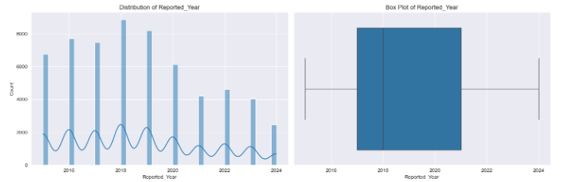
The bar graph shows the distribution of reported cases from 2010 to 2024.
We observe fluctuations in the number of cases over the years. Some years have higher counts, while others have lower ones.
The line graph overlay suggests a trend or average, but without specific values, we can’t determine the exact pattern.

Slide 16
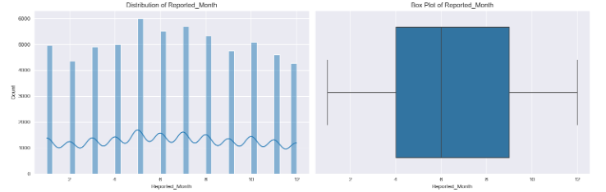
Fluctuations Over Time:
The line graph shows the count of reported cases each month.
We observe variability, with peaks and troughs.
Some months have higher case counts, while others are lower.
Trend and Seasonality:
The overall trend appears to be upward, but it’s essential to consider seasonality.
Are there specific months consistently associated with higher or lower reports?

Slide 17
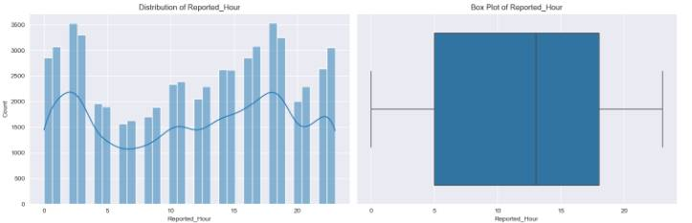
Overall Distribution: The distribution of reported hours seems to fluctuate throughout the day, indicating varying levels of activity or incident reporting. The pattern is not uniform, showing multiple peaks and troughs.
Peak Reporting Hours: There appear to be peaks in the number of reported cases around certain hours, specifically at 0 (midnight), 7 AM, and again around 18-20 (6 PM to 8 PM). These peaks suggest higher activity or incidents occurring or being reported during these times.

Slide 18
Univariate analysis on categorical columns
Focuses on understanding the distribution of values within a single variable. When applied to categorical columns, it involves examining the frequency of different categories or labels within that column.

Slide 19
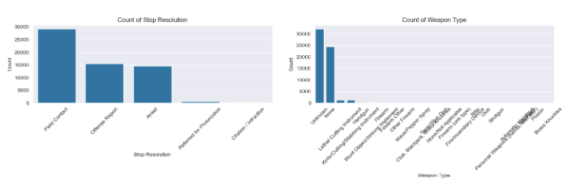
The charts indicate that the majority of law enforcement stops result in "Field Contact," with relatively few escalating to more serious outcomes like "Officer Report," "Arrest," "Cited / Infraction," or "Referred for Prosecution." Most stops involve unarmed individuals, with very few cases involving weapons such as "Lethal Cutting Instruments" or "Firearms." This suggests that while there are many interactions between law enforcement and the public, only a small proportion involve weapons or lead to serious legal consequences, implying that most stops are routine and do not escalate into significant incidents.

Slide 20
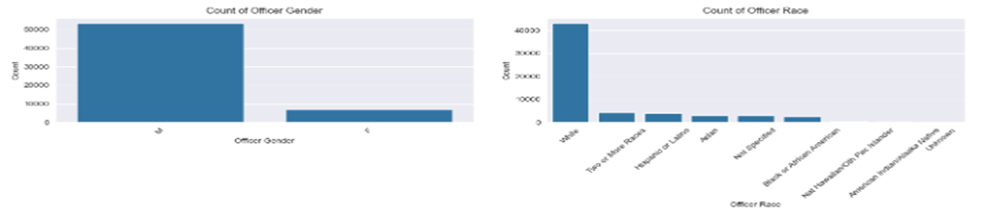
The charts reveal that the majority of officers involved in the data are male, with a significantly smaller proportion of female officers. Additionally, the "White" racial category is the most prevalent among officers, far outnumbering other racial categories such as "Two or More Races," "Hispanic or Latino," "Asian," "Not Specified," "Black or African American," and "American Indian/Alaskan Native." This indicates a noticeable gender and racial disparity in the officer demographic composition within the dataset.

Slide 21
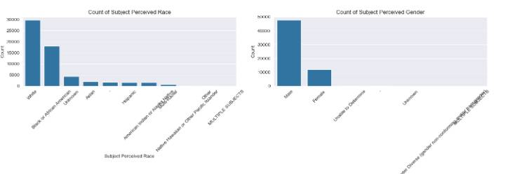
Reported Cases Over Time:
The bar graph shows fluctuations in reported cases from 2010 to 2024.
Some years have higher counts, while others are lower.
The box plot summarizes the distribution across years.
Monthly Trends:
The line graph displays monthly case counts.
Peaks suggest higher reporting during specific months.
The box plot provides insights into monthly variability.

Slide 22
Exploratory Data Analysis
Bivariate Analysis
Scatter Plots: Explored relationships between pairs of numerical features.
Boxplots/Barplots: Compared distributions across different categories.
Count Plots Vs Targted Variable: Visualize the relationship between categorical features and the target variable.

Slide 23
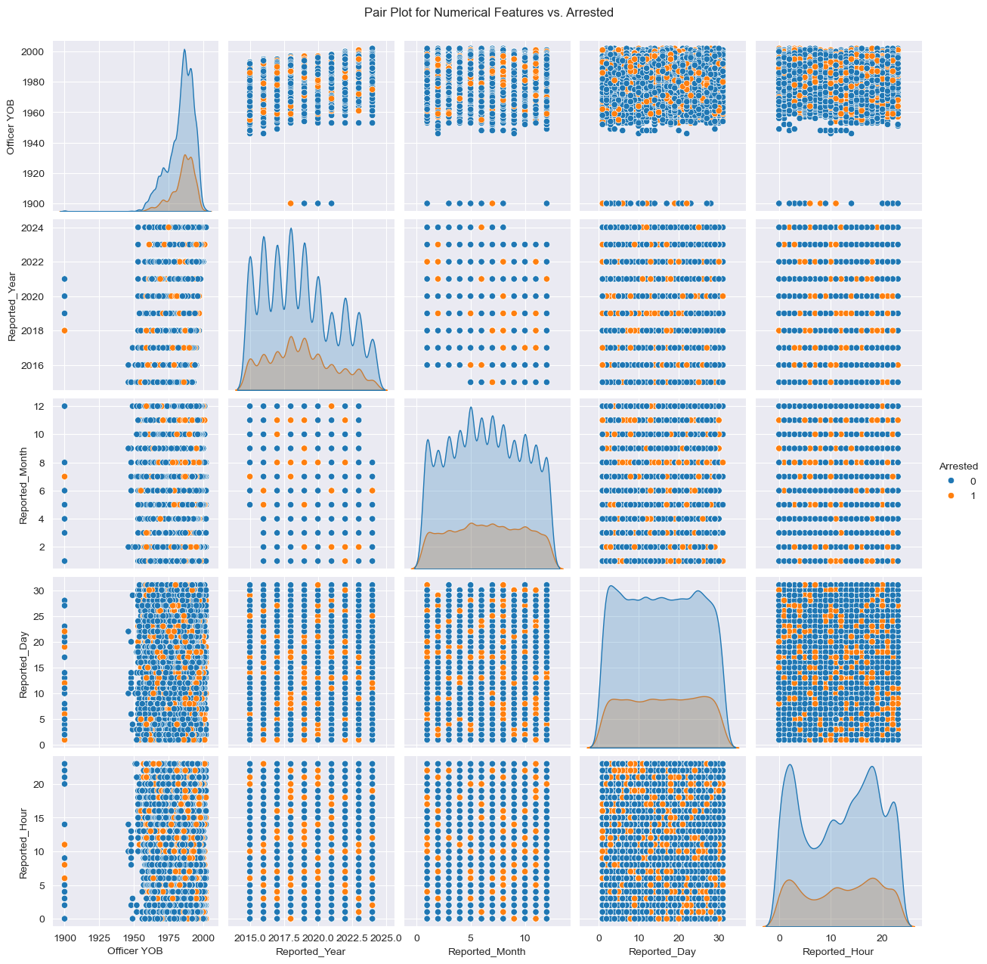
Officer YOB (Year of Birth): There is a slight indication that older officers (those born before the 1970s) may be associated with a higher likelihood of making an arrest (Arrested = 1). However, the relationship is not strong and may not provide substantial predictive power on its own.
Reported Year and Reported Month: These features appear uniformly distributed with no distinct patterns separating the two classes (Arrested = 0 and Arrested = 1). This suggests that the year or month of the report is not significantly contributing to distinguishing between arrests and non-arrests.
Reported Day: The Reported_Day feature also does not show strong patterns or separations between the arrest and non-arrest classes. Arrests appear relatively spread out across different days, indicating no particular trend.
Reported Hour: The Reported_Hour feature exhibits some clustering where arrests (Arrested = 1) are more likely to occur during specific periods, such as early morning or late evening. This may suggest a potential time-based trend, but it requires further analysis to be definitive.

Slide 24
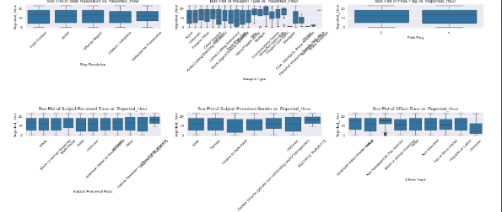
The boxplots show the distribution of the Reported Hour across various categorical variables. For Stop Resolution, the distribution is consistent, suggesting that the time of day does not vary significantly by stop type. The Weapon Type boxplot shows more variation in Reported Hour, indicating some temporal patterns related to weapon types. The Frisk Flag and Arrest Flag plots are evenly distributed, implying time of day is not strongly linked to frisk or arrest occurrences. Other plots, such as Subject Perceived Race, Subject Perceived Gender, and Officer Race, show uniform distributions, indicating no distinct temporal patterns with Reported Hour.

Slide 25
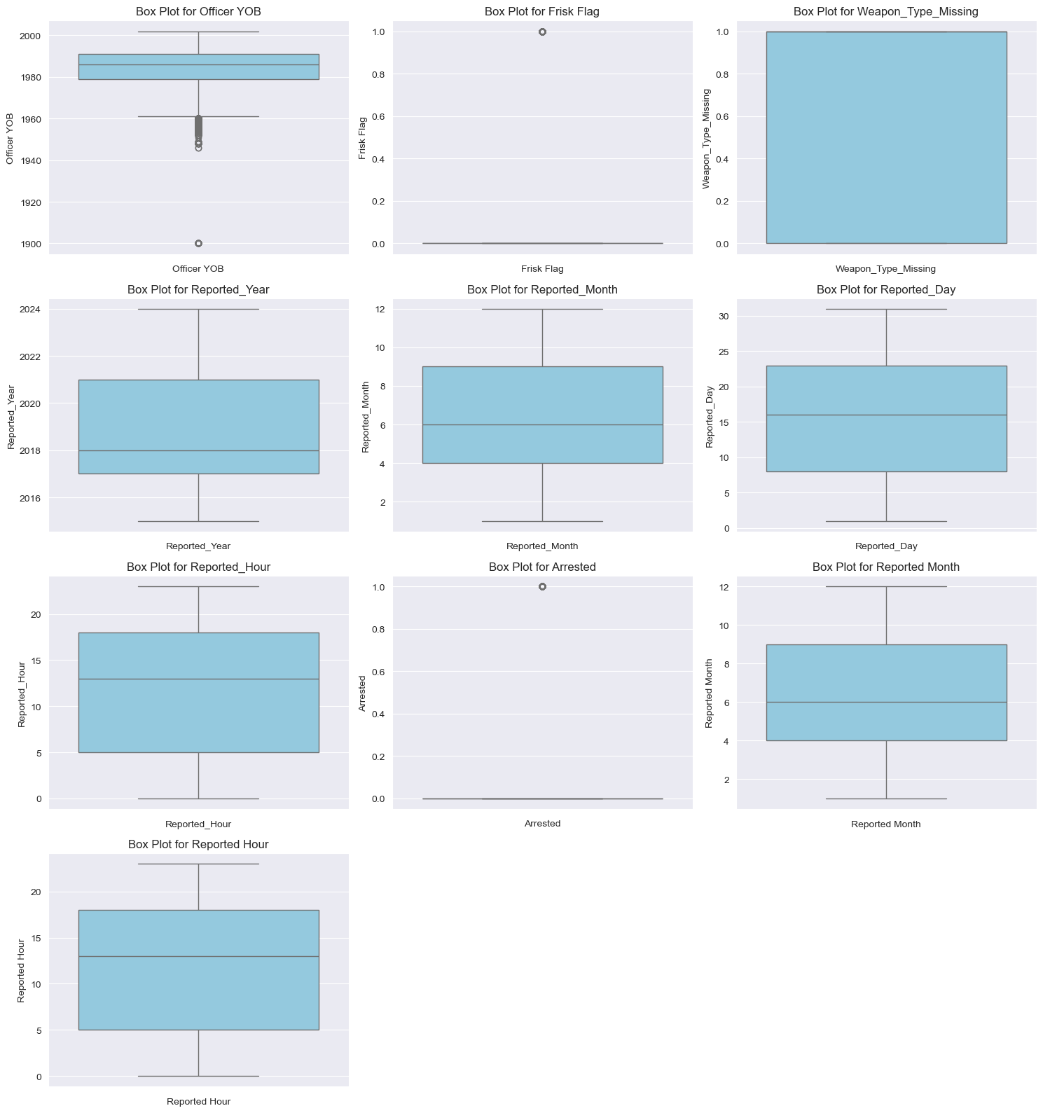
Checking for Outliers
Identify and analyze any unusual or extreme values in our dataset that could distort our results or model performance. Outliers can arise from data entry errors, rare events, or natural variations in the data, and may significantly impact the accuracy and reliability of our predictive models.

Slide 26
Feature Engineering
Enhances model performance by making patterns in the data more visible to machine learning algorithms.
Improves model interpretability by focusing on meaningful features.
Helps prevent overfitting by reducing the number of irrelevant features.
Facilitates better generalization to unseen data by capturing underlying relationships.

Slide 27
Data Preparation for Modelling
Feature scaling helped mitigate the impact of outliers and bring all numerical columns to a comparable scale, enhancing the stability and accuracy of our predictive models. We employed robust scaling techniques to manage the influence of extreme values effectively.

Slide 28
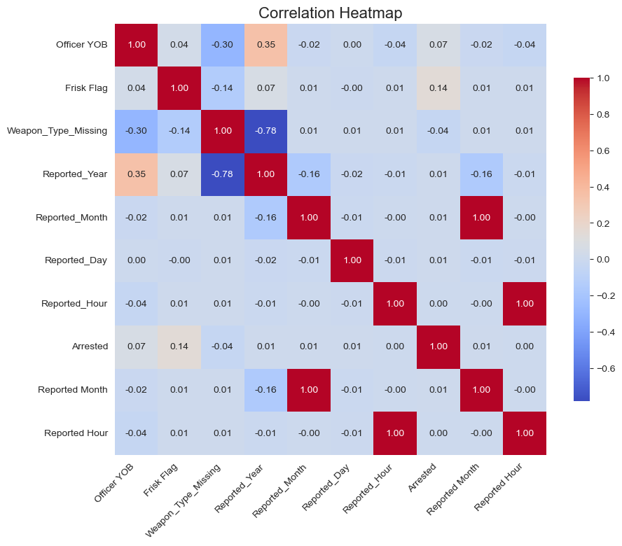
Correlation Analysis
Correlation Analysis: Visualized using a heatmap to identify relationships between numerical features

Slide 29
Data Splitting for Training and Testing
To prepare our data for modeling, we'll follow these steps:
Feature Selection:
We'll define our features (independent variables) and store them in a variable called X.
These features represent the input variables that we'll use to predict the target variable.
Target Variable Definition:
Our target variable (dependent variable) is whether a customer has exited (churned) or not.
We'll store this target variable in a variable called y.
Data Splitting:
We'll split our dataset into training and testing subsets.
The training set will be used to train our machine learning model.
The testing set will be used to evaluate the model's performance.

Slide 30
Model Training and Evaluation
Objective: Develop, train, and evaluate predictive models to determine the likelihood of an arrest following a Terry Stop.
Feature Scaling: We'll apply feature scaling to the numerical features to improve the performance of our model.

Slide 31
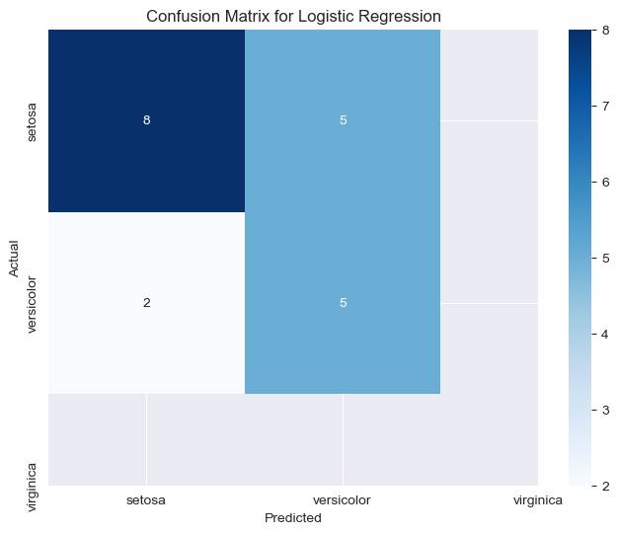
Logistic Regression performance
Accuracy: 0.7000
Precision: 0.6667
Recall: 0.5000
F1 Score: 0.5714

Slide 32
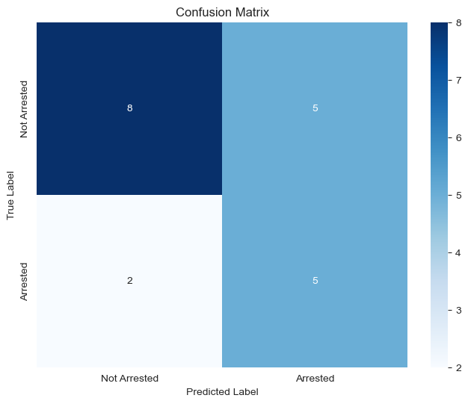
Decision trees performance
Accuracy: 0.6500
Precision: 0.5000
Recall: 0.7143
F1 Score: 0.5882

Slide 33
conclusion
-Model Development: A binary classification model was built to predict arrest outcomes, aiming to assist law enforcement with decision-making and potentially reduce unnecessary detentions.
Data Analysis: The dataset included features like presence of weapons, time of day, and demographic details. Missing values and outliers were addressed, and categorical variables were encoded for model compatibility.
Ethical Considerations: The project underscores the importance of considering gender and race in arrest outcomes, hinting at potential biases that need to be investigated and addressed.

Slide 34
recommendations
Further research could explore the impact of additional variables not included in the current dataset.
Advanced modeling techniques could be employed to improve prediction accuracy beyond the current 70% threshold.
A deeper analysis into the potential biases related to gender and race could provide more nuanced understanding and inform training programs for officers.

Slide 35
THANK YOU
ERIC RONO

